Slide 1
Eclipse Modeling Framework (EMF)
Paweł Żalejko

Slide 2
Agenda
Model-Driven Development
What is EMF?
EMF demo - hello world
EMF demo - command stack & adapters
EMF demo - data binding & validation
EMF demo - generating UI editors

Slide 3
Agenda
Model-Driven Development
What is EMF?
EMF demo - hello world
EMF demo - command stack & adapters
EMF demo - data binding & validation
EMF demo - generating UI editors

Slide 4
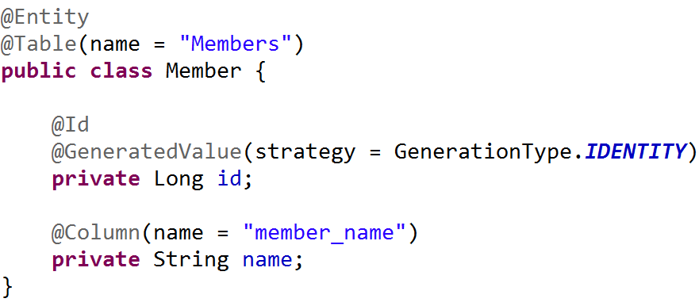
Model-Driven Development

Slide 5
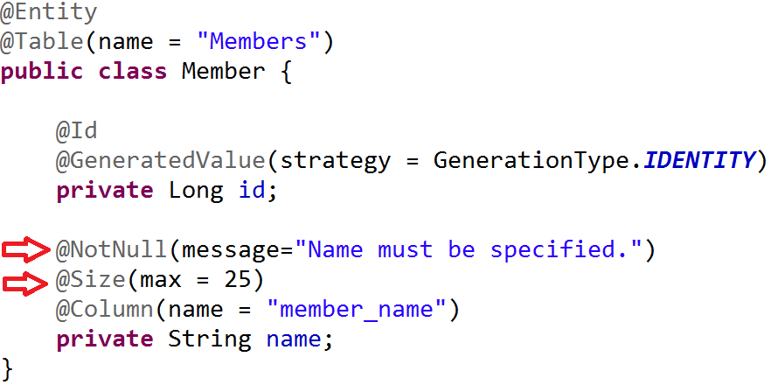
Model-Driven Development

Slide 6
Model-Driven Development
Clear visibility
Flexibility(models can be adjusted)
Fast & cost-effective
Leads to increased quality
Enforces architecture
Let’s programmers focus on the hard stuff

Slide 7
Agenda
Model-Driven Development
What is EMF?
EMF demo - hello world
EMF demo - command stack & adapters
EMF demo - data binding & validation
EMF demo - generating UI editors

Slide 8
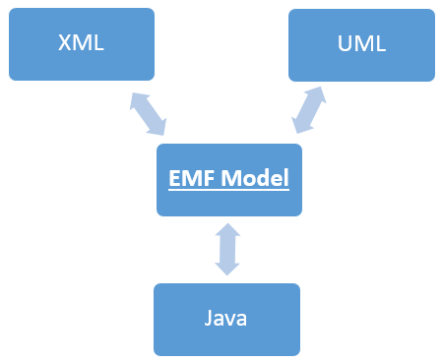
What is EMF?
Modeling framework
Code generator
Framework for building tools and applications based on a structured data model

Slide 9
EMF - frameworks
Persistence
CDO, EMFStore, Teneo
UI frameworks
EMF Forms
Graphical Modeling
GMF, Sirius
Textual Modeling
Xtext
And much more...
https://eclipse.org/modeling/

Slide 10
Agenda
Model-Driven Development
What is EMF?
EMF demo - hello world
EMF demo - command stack & adapters
EMF demo - data binding & validation
EMF demo - generating UI editors

Slide 11
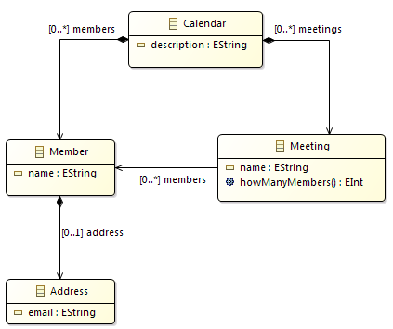
EMF demo - hello world
Create a model
Eclipse Modeling IDE
Create a new Ecore Modeling Project
Generate the code
About the model:
4 classes
Integer and String attributes
1 operation (method)
Containment and non containment refs.

Slide 12
EMF – ecore & genmodel
Two files:
ecore - contains the information about the defined classes
genmodel - contains information for the code generation

Slide 13
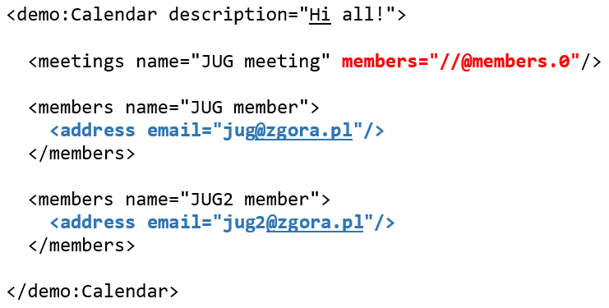
EMF – containment vs non containment

Slide 14
Object vs EObject
EObject is the root of all modeled objects
It provides support for the behaviors and features common to all modeled objects:
Reflection | Content
eClass eGet eSet ... | eResource eContainer eContents ...

Slide 15
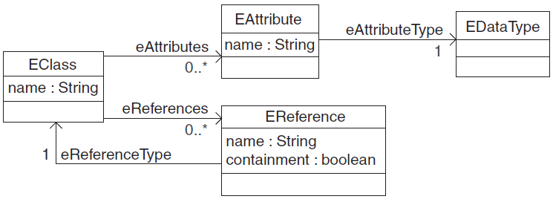
EMF – Ecore (Meta) Model
model of a model ☺:
EClass
EStructuralFeature
EAttribute
EReference
EOperation
EDataType

Slide 16
Agenda
Model-Driven Development
What is EMF?
EMF demo - hello world
EMF demo - command stack & adapters
EMF demo - data binding & validation
EMF demo - generating UI editors

Slide 17

EMF demo - command stack & adapters
Editing objects using commands
Undo/redo
Adapters as change listeners

Slide 18
Agenda
Model-Driven Development
What is EMF?
EMF demo - hello world
EMF demo - command stack & adapters
EMF demo - data binding & validation
EMF demo - generating UI editors

Slide 19
EMF demo - data binding & validation
Binding a model to UI controls
DataBindingContext
IObservableValue
UpdateValueStrategy
Validating inputs
Java
Object Constraint Language (OCL)

Slide 20
Agenda
Model-Driven Development
What is EMF?
EMF demo - hello world
EMF demo - command stack & adapters
EMF demo - data binding & validation
EMF demo - generating UI editors

Slide 21
EMF demo - generating a UI editor
A simple UI editor created using EMF Forms framework
UI:
JavaFX
SWT
Eclipse RAP
http://www.eclipse.org/ecp/emfforms/

Slide 22
EMF demo - generating a Sirius-based editor
Sirius:
„Sirius is an Eclipse project which allows you to easily create your own graphical modeling workbench by leveraging the Eclipse Modeling technologies, including EMF and GMF.”
https://eclipse.org/sirius/overview.html

Slide 23

Thanks!
https://eclipse.org/modeling/
https://eclipse.org/modeling/emf/
http://www.eclipse.org/modeling/emf/docs/
http://www.eclipse.org/ecp/emfforms/
https://eclipse.org/sirius/overview.html

